Slide 1
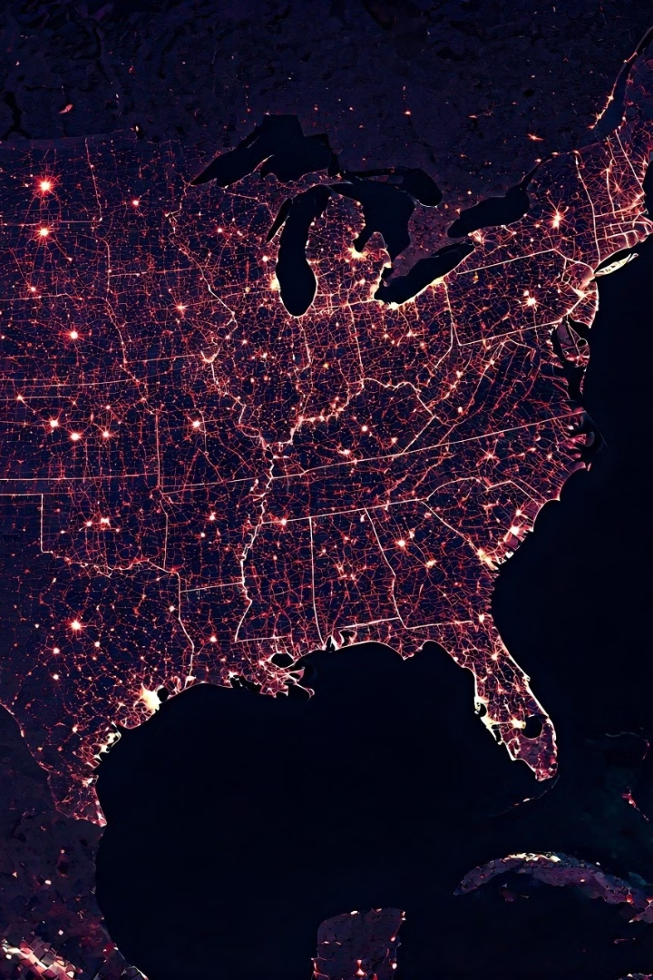
Nationwide Distribution Company
Optimizing salesman routes for efficiency and profitability
BY Ranjith Kumar R - 192210687

Slide 2
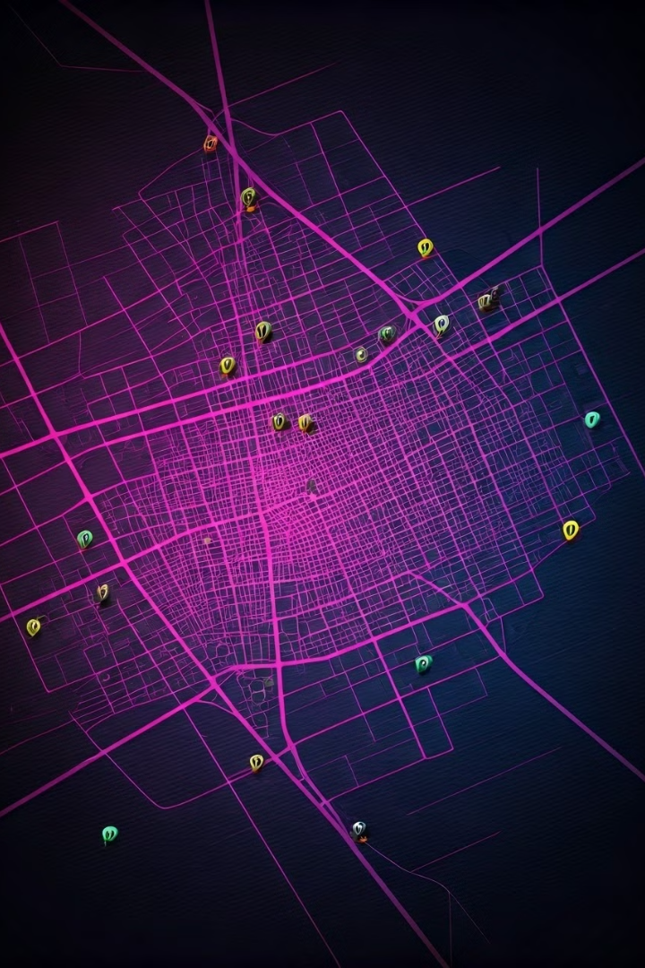
Challenges in Route Optimization
1
Traffic Congestion
2
Distance and Time Constraints
Unexpected delays and wasted time
Balancing coverage with time constraints
3
Dynamic Conditions
4
Delivery Deadlines
Weather, road closures, and unexpected events
Meeting customer expectations and deadlines

Slide 3
Factors Affecting Route Optimization
Customer Locations
Delivery Windows
Delivery Volume
Geographic distribution of customers
Specific timeframes for deliveries
Quantity of goods to be delivered

Slide 4

Data Collection and Analysis
Historical Sales Data
Real-time Traffic Data
Past customer orders and delivery patterns
Traffic conditions, road closures, and accidents
Customer Location Data
Salesman Performance Data
Precise addresses and coordinates
Tracking delivery times and efficiency

Slide 5




Route Optimization Algorithms
Nearest Neighbor Algorithm
Simple and efficient, but not always optimal
Genetic Algorithm
Iterative optimization, evolving routes to find the best
Ant Colony Optimization
Inspired by ant behavior, finding shortest paths

Slide 6
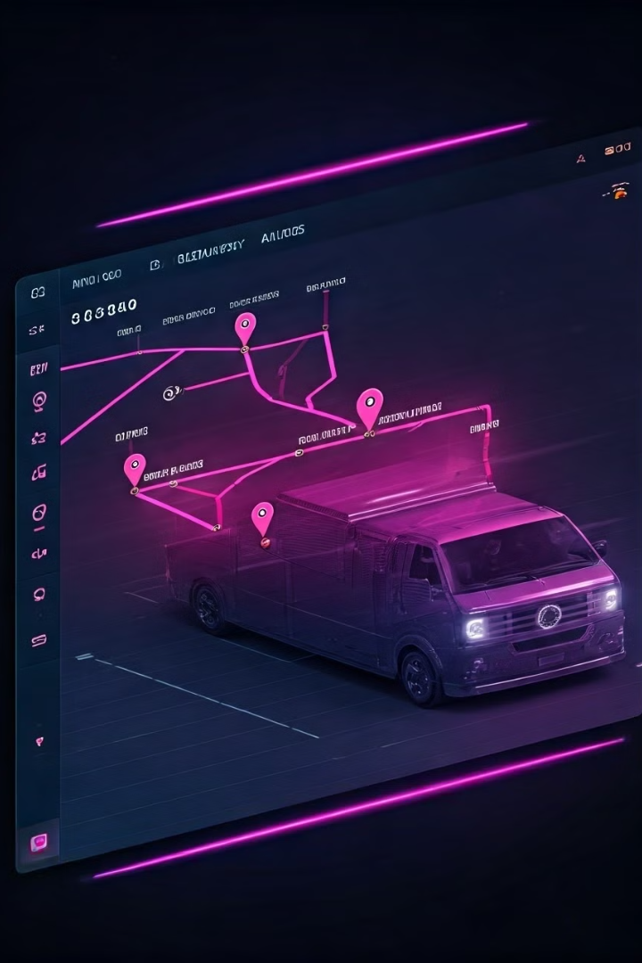
Implementing Route Optimization
1
Data Integration
Combining different data sources into a unified system
2
Algorithm Selection
Choosing the best algorithm for specific needs
3
Software Implementation
Developing or integrating route optimization software
4
Route Planning and Deployment
Generating optimized routes and assigning them to salesmen

Slide 7
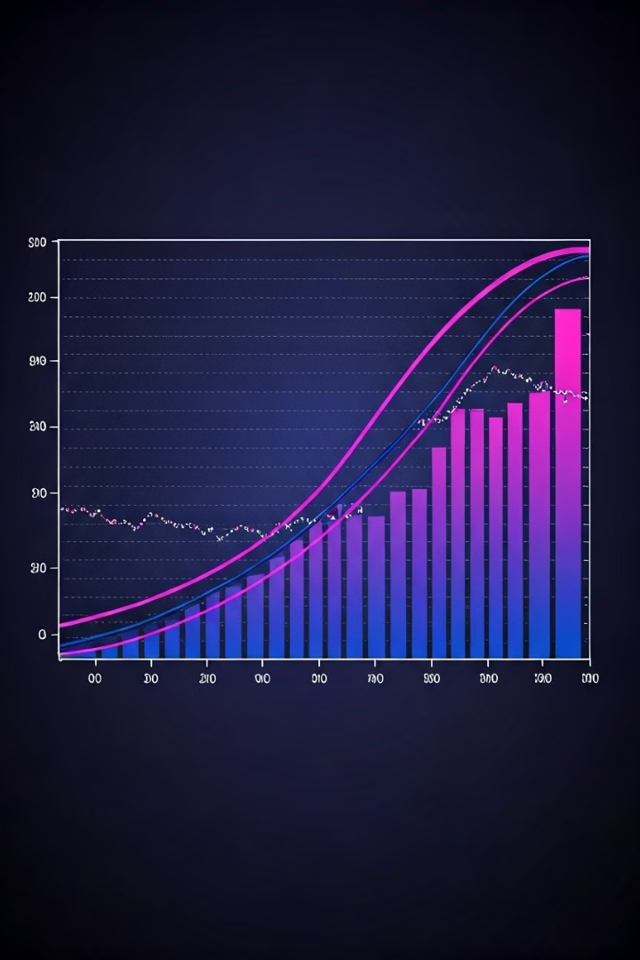
Time and Space Complexity
Algorithm
Time Complexity
Space Complexity
Nearest Neighbor
O(n^2)
O(n)
Genetic Algorithm
O(n*m)
O(n*m)
Ant Colony Optimization
O(n^2)
O(n*m)

Slide 8
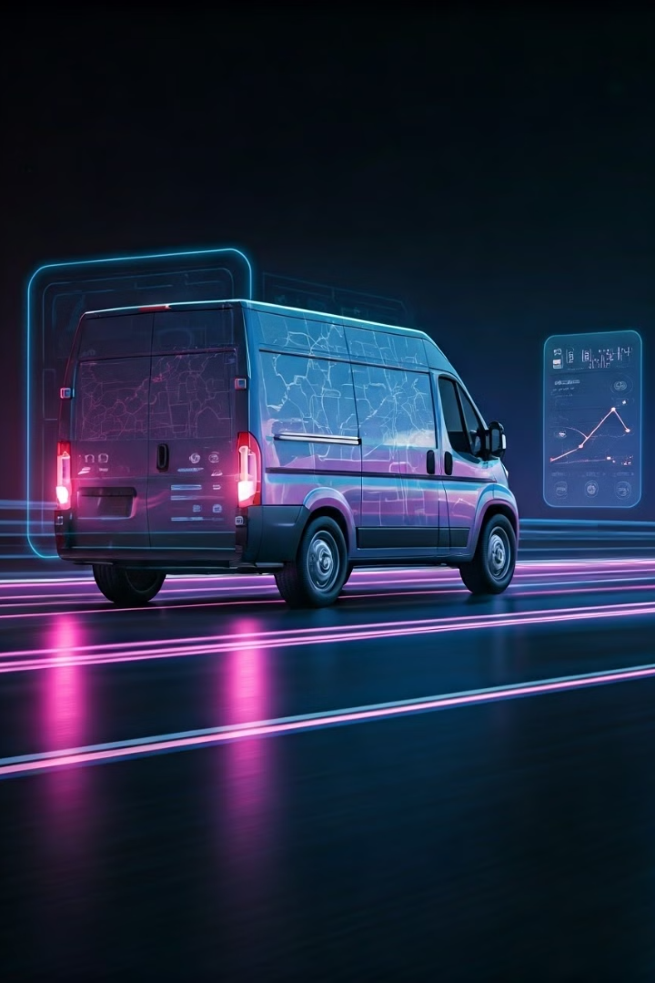




Monitoring and Adjusting Routes
Delivery Time Monitoring
Traffic Updates
Tracking delivery times against planned routes
Incorporating real-time traffic data into route adjustments
Salesman Feedback
Data Analysis
Gathering insights from salesmen on route efficiency
Analyzing route performance to identify areas for improvement

Slide 9

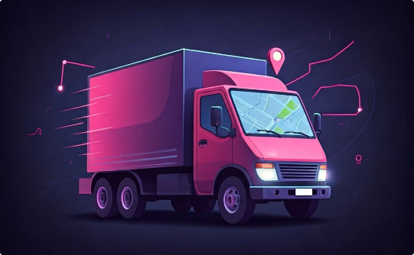

Benefits of Optimized Salesman Routes
Improved Customer Satisfaction
Increased Salesman Productivity
Reduced Operational Costs
Lower fuel consumption, fewer delays, and less downtime
On-time deliveries and efficient service
More deliveries per day, maximizing coverage

